Slide 1
Lab 2 Class
DEE 1319
Department of Electronics Engineering
National Chiao Tung University

Slide 2
Class
C++ supports object-oriented programming (OOP)
Aim of C++ class is to provide programmer a means for creating new types that can be used as conveniently as built-in types
C++ class is much more powerful than structure in C
not just data members
add member functions
add access control mechanism

Slide 3
Class Definitions (1/2)
Example:
class Complex{ // name of class type
private: // access specifier
int realPart; // data member declaration
int imaginaryPart; // data member declaration
public: // access specifier
Complex(int=0,int=0); // constructor
~Complex(); // destructor
int get_realPart(); // member function declaration
int get_imaginaryPart(); // member function declaration
};

Slide 4
Class Definitions (2/2)
Typically, only member function’s declaration in class definition
function’s implementation is elsewhere
Define a class => Define a new type !

Slide 5
Private vs. Public (1/3)
Private:
Can’t access outside the class scope
int main(){
Complex comp;
cout << comp.realPart << endl; // error!!
return 0;
}
Can access inside the class scope
int Complex::get_realPart() {return realPart;}

Slide 6
Private vs. Public (2/3)
Public:
Can access through dot ( . ) or arrow ( -> ) outside the class scope
E.g.,
int main(){
Complex comp;
cout << comp.get_realPart() << endl;
return 0;
}

Slide 7
Private vs. Public (3/3)
Both data members and member functions can be either private or public
Data members are usually private
you do not know exact representation
object is manipulated through member functions
Member functions are usually public
you can use public interface for object manipulations
you still do not know how these member functions get implemented

Slide 8
Class Member Functions
Example:
int Complex::get_realPart(){
……
}
Like other function definitions
place outside class definition
must specify the class it belongs to
different classes can have member functions with same name
:: is called scope resolution operator

Slide 9
Constructor
Example:
Complex::Complex(int real, int imaginary){
……
}
Constructors called when objects defined
Can initialize class members

Slide 10
Destructor
Example:
Complex::~Complex(){
……
}
Destructors called when objects leave scope
Performs termination housekeeping before the system reclaims the object’s memory

Slide 11
Passing Class as Argument
Use class as a new type
Example:
Complex add_two_complexes(Complex a, Complex b){
……
}
Return type: Complex
Parameter a’s type: Complex
Parameter b’s type: Complex

Slide 12
Lab Exercise (1/5)
Define and implement a new class “nctuGrade”
These are 3 private data members
PhysicsGrade
CalculusGrade
OopGrade
Implement get and set member function to read and write the value of 3 private data members
There is 1 public data member
ID, which store the NCTU student ID
You can not move phy_score, cal_score, oop_score to public.

Slide 13
Lab Exercise (2/5)
Input:
Student ID
Physics grade
Calculus grade
Oop grade
Keep record students’ data until input -1 to student ID

Slide 14
Lab Exercise (3/5)
Output:
Report statistics information
number of students
average grades of Physics ,Calculus ,Oop
pass(≧60) rates of Physics ,Calculus ,Oop
Report student’s information
Print student’s ID
Average grade of student’s Physics ,Calculus ,Oop
Pass or fail for each subject

Slide 15
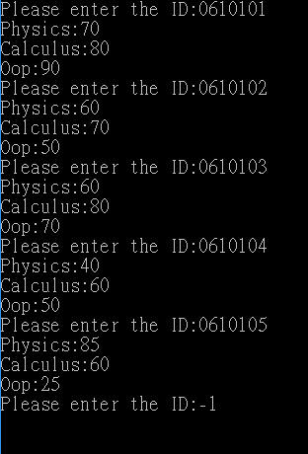
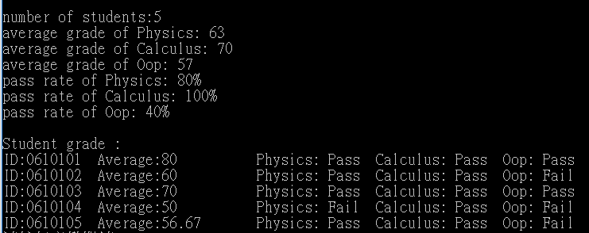
Lab Exercise (4/5)
input
output

Slide 16
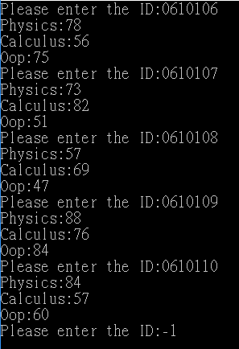
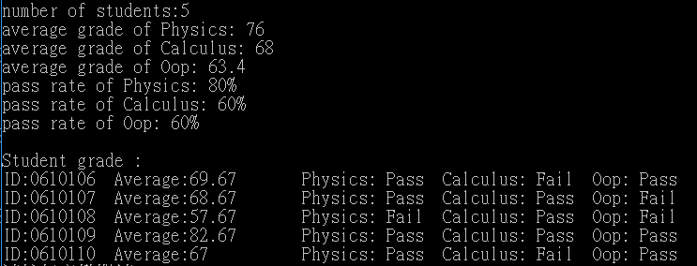
Lab Exercise (5/5)
input
output

Slide 17
Homework (1/5)
Define and implement two new class “Rectangle” and “Triangle”
These are 2 private data members for Rectangle
width
height
These are 2 private data members for Triangle
width
height
Note: width and height will be unsigned integer

Slide 18
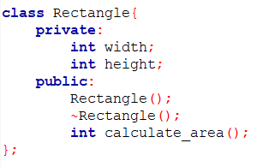
Homework (2/5)
Define and implement two new class “Rectangle” and “Triangle”
Implement a member function for each class to calculate the area of polygon
E.g.,
Note: add other function in public if needed

Slide 19
Homework (3/5)
Implement a function “compare_polygon” who passes class “Rectangle” and class “Triangle” as arguments
Compare the area of rectangle and triangle
If area of rectangle > triangle, print 0
If area of rectangle = triangle, print 1
If area of rectangle < triangle, print 2

Slide 20
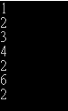
Homework (4/5)
Flow of homework:
Input rectangle’s width
Input rectangle’s height
Input triangle’s width
Input triangle’s high
Output area of rectangle
Output area of triangle
Output the message of compare_polygon
Termination of program

Slide 21


Homework (5/5)
Example 2 Example 3

